Slide 1
UCB - CS189 Introduction to Machine Learning Fall 2015 Lecture 10: Model search
Isabelle Guyon
ChaLearn

Slide 2

Come to my office hours… Wed 2:30-4:30 Soda 329
Last time
Next time

Slide 3
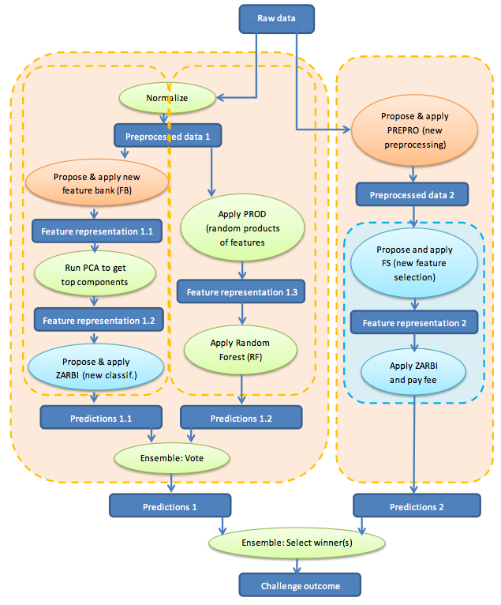
Come to my office hours… Wed 2:30-4:30 Soda 329
Today: model search

Slide 4
Remember: The DREAM
AutoML
black box
Trained
model
TRAINING
DATA
Answer y
?
Query x

Slide 5

Remember: The REALITY
Hyper-parameter tuning
Trained
model
TRAINING
DATA
Answer y
?
Query x
http://codalab.org/AutoML
5

Slide 6


Changing roles again!
LAST TIME
TRAINING
DATA
THE
BOSS
TEST
DATA
kNN Linear SVM RF boosting
THE ML “STAFF”

Slide 7
Changing roles again!
TRAINING
DATA
DATA SCIENTIST
Validation
set
THE
BOSS
Training
set
TEST
DATA
kNN Linear SVM RF boosting
THE ML “STAFF”

Slide 8


Slide 9
DATA SCIENTIST
Validation
set
You are tuning the hyperparameters θ.
Your “training data” is the validation set.

Slide 10
Produce 3 models: 1) “Hebb’s rule” linear model f(x) = w • x = Σ_{k} y_{k} x^{k} • x 2) Regularized linear model f(x) = w • x = Σ_{k} α_{k} x^{k} • x 3) Parzen windows f(x) = Σ_{k} y_{k} k(x^{k}, x) 4) Non-linear model f(x) = w • Φ(x) = Σ_{k} α_{k} k(x^{k}, x)
4
d
y ={y^{k}}
X={x^{k}_{i}}
x^{k}
N
α
w

Slide 11
What are hyper-parameters
Preprocessing (feature selection, feature construction, feature or pattern normalizations, etc.) [~ 3 HP]
Model (linear, kernel, kNN, decision trees, etc.) [1 HP]
Model hyper-parameters (number of neighbors in kNN, kernel choice polynomial or Gaussian, kernel parameters q, σ, number of layers and hidden units in neural nets, tree depth in decision trees, etc.) [~ 2 HP]
Loss function (hinge, logistic, square-loss, etc.) [1 HP]
Regularizer (2-norm, 1-norm, regularization parameter λ) [2 HP]
Learning rate η for gradient descent. [1 HP]
Etc. [Total ~ d=10 HP]

Slide 12
Hyper-models
You can create workflows (directed acyclic graphs) of all the modules available in your machine learning toolkit!

Slide 13
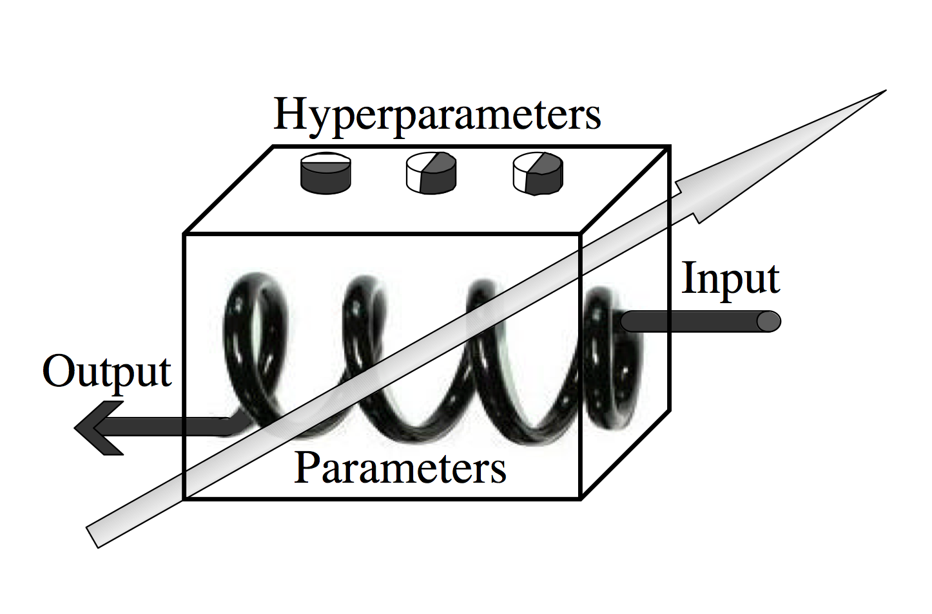
Model selection / hyper-parameter search
Output
Input

Slide 14
Model selection / hyper-parameter search

Slide 15
Search strategies
Filters
Wrappers
Embedded
methods

Slide 16
Wrappers: your learning machine is a black box
θ
Output
Input
You cannot compute ∇_{θ}R or ∂R/∂θ_{i}
No gradient descent!

Slide 17
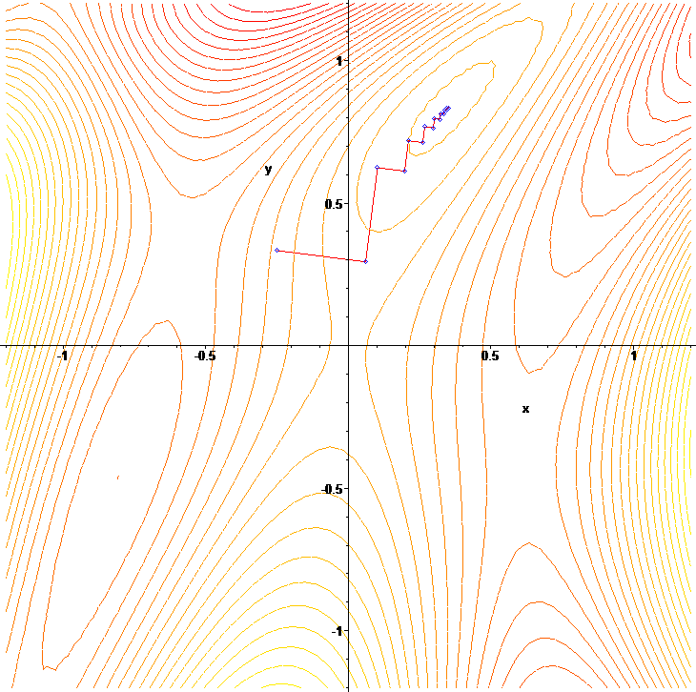
What the learning machines do:
w2
w ← w - η ∇_{w}R
η too small: many steps needed to converge.
η too large: zigzags.
Contours
R[w1, w2]=cte
w1
Picture from Wikipedia

Slide 18
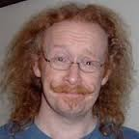
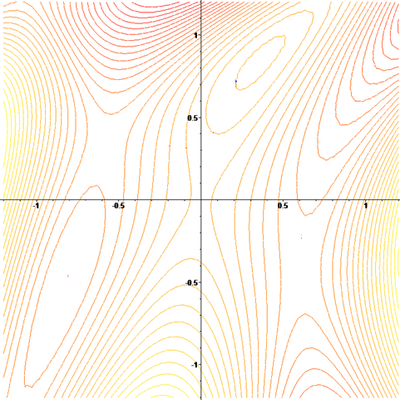
What you have to do:
θ2
Grid search is best
Prof. G, Cawley
Grid search:
Evaluate R[θ]
on grid nodes only to find min_{θ} R.
Δθ small: too slow.
Δθ large: miss the optimum.
Contours
R[θ1, θ2]=cte
θ1
Δθ
Picture from Wikipedia

Slide 19
Grid search
Advantages:
Simple.
Does not fall into local minima.
Disadvantage:
Scales poorly: for g grid points in each of the d dimensions, g^{d} evalulations of R[θ]! Example: d=10, g=10. 10¹⁰ =10,000,000 evaluations. One evaluation means TRAINING ONE MODEL! (OR SEVERAL MODELS IN THE CASE OF K-FOLD!!)

Slide 20

Your options
Reduce the number of hyper-parameters.
Learn how to do “fancy” search.

Slide 21
Filter methods
You chose: Reduce HP space

Slide 22
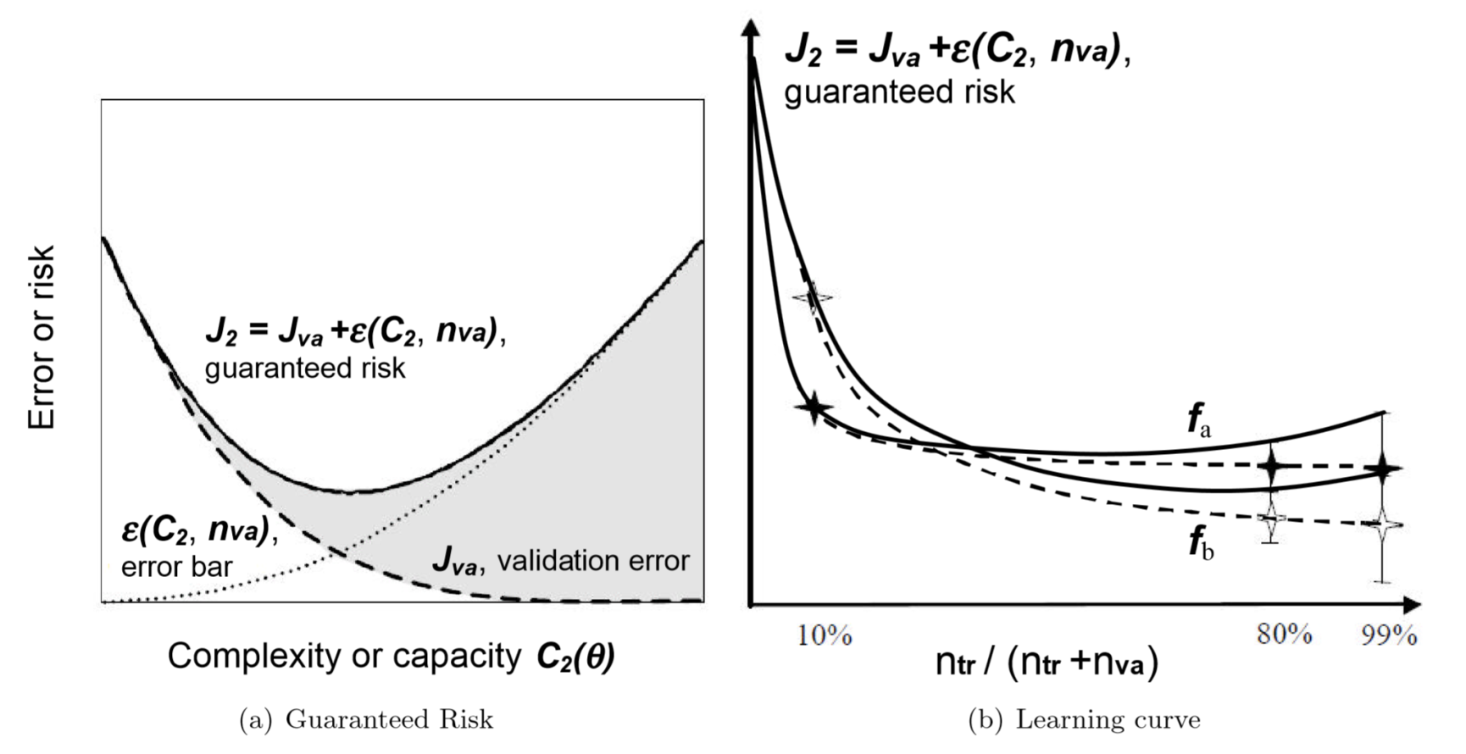
Good choice!
You chose: Reduce HP space
Reducing HP space ALSO reduces the risk of overfitting!

Slide 23
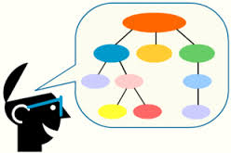

Prior knowledge
You chose: Reduce HP space
Market
Analysis
10⁶
Ecology
Computer
Vision
OCR
HWR
10⁵
Text
Categorization
10⁴
N training examples
10³
System diagnosis
10²
Bioinformatics
10
d inputs
10
10²
10³
10⁴
10⁵
10⁶

Slide 24

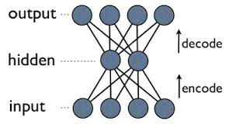
Unsupervised learning
You chose: Reduce HP space
Space dimensionality reduction with PCA (Principal Component Analysis).
Unsupervised “pre-training” with (staked) auto-encoders.
Source: http://www.nlpca.org/

Slide 25
Transfer learning
You chose: Reduce HP space
P
C
Task
labels
Source
domain
John

Slide 26
Transfer learning
You chose: Reduce HP space
P
R
Source
domain

Slide 27
Transfer learning
You chose: Reduce HP space
P

Slide 28
Transfer learning
You chose: Reduce HP space
P
P
C
Task
labels
Target
domain
John
http://www.causality.inf.ethz.ch/unsupervised-learning.php

Slide 29
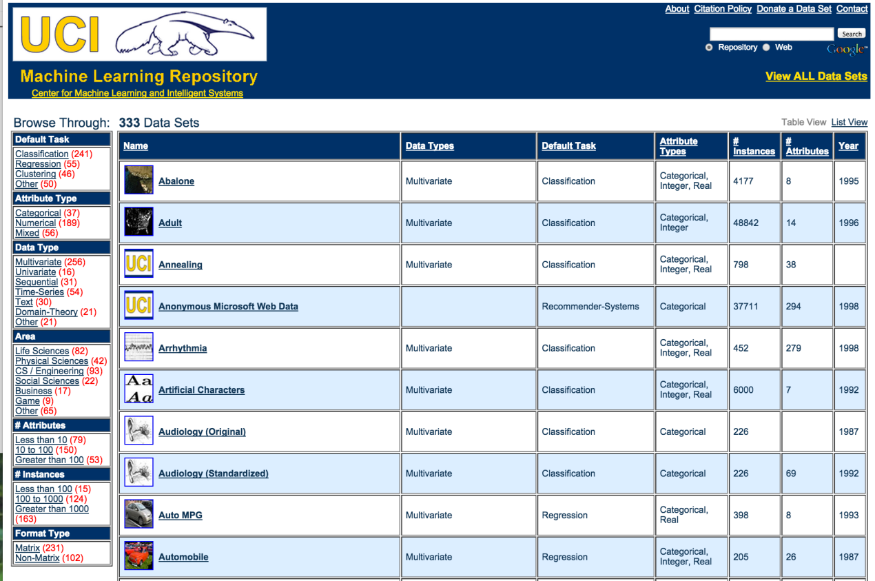
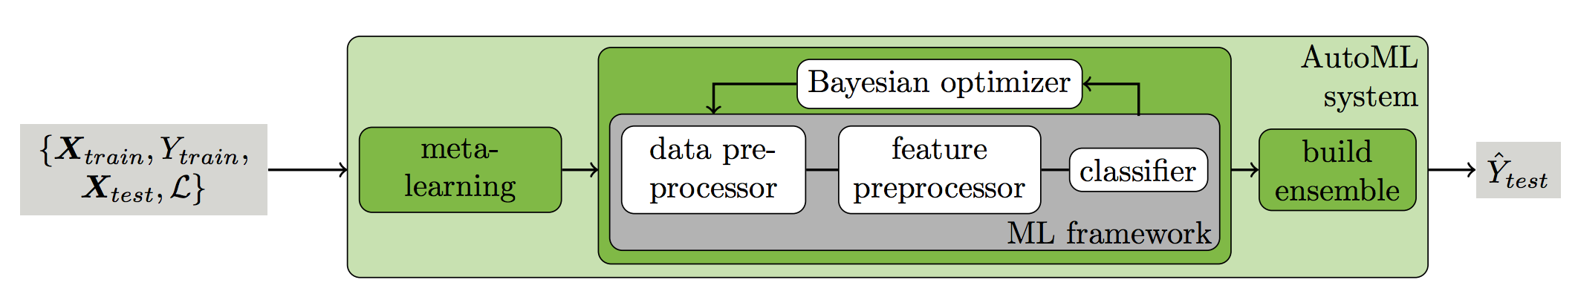
Meta learning
You chose: Reduce HP space
Methods for Improving Bayesian Optimization for AutoML
Matthias Feurer, Aaron Klein, Katharina Eggensperger, Jost Tobias,
Manuel Blum, Frank Hutter, ICML workshop on AutoML, 2015.

Slide 30
Pre-selection with a surrogate learning machine
You chose: Reduce HP space
Take a simplistic learning machine (fast to train).
Select a bunch of HP with this LM.
Example: univariate filter methods of feature selection.

Slide 31
“Fancy” search (a.k.a. heuristic search)
You chose:
Fancy search
Intensive search:
Simulated annealing of MCMC.
Genetic algorithms.
Particle swarm optimization.
Greedy search:
Nelder-Mead/simplex.
Pattern search.
Nested subsets.

Slide 32
Intensive search Example: simulated annealing
You chose:
Fancy search
Random walk on a search graph:
θ = θ₀, T = T₀
for k = 0 to k_{max}:
T ← temperature(k) annealing schedule
θ_{new} ← random_neighbor(θ) transition probability
if P(R[θ], R[θ_{new}], T) ≥ random(0, 1):
θ ← θ_{new}
return θ
acceptance probability:
P(E, E’, T) = 1 is E’<E and exp(-(E’-E)/T) otherwise

Slide 33
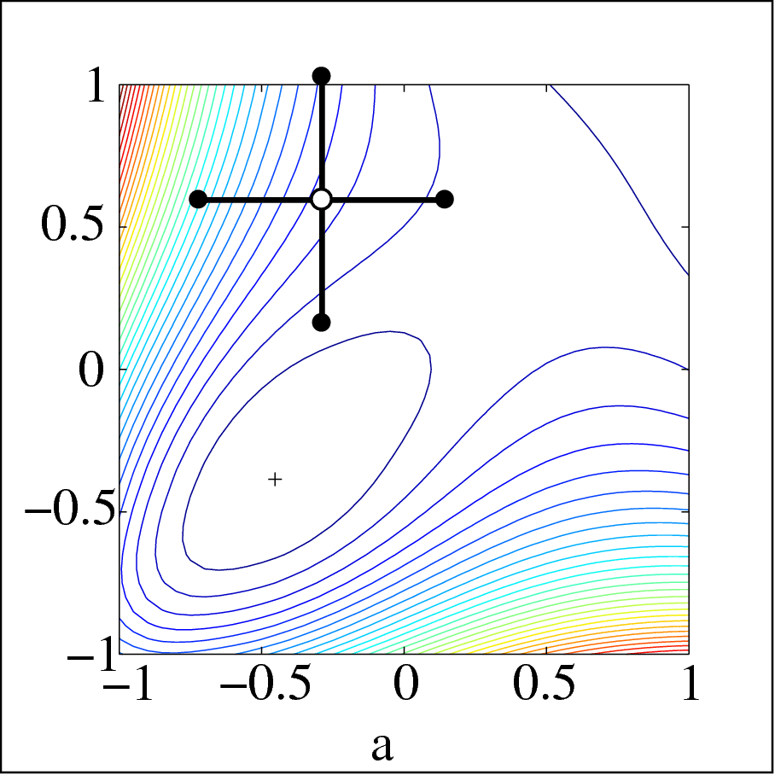
Greedy search Example: pattern search
You chose:
Fancy search
θ₂
θ₁
Choose a direction i
Vary θ_{i} by steps of the same magnitude (positive or negative) until a minimum of R[θ] is reached
Half the step size and choose another θ_{i}
https://en.wikipedia.org/wiki/Pattern_search_(optimization)

Slide 34
Cross-validation
X
y
Learning = adjusting:
parameters (w vector).
hyper-parameters (γ, ν, q, σ).
Cross-validation with K-folds:
For various values of γ, ν, q, σ:
- Adjust w on a fraction (K-1)/K of training examples e.g. 9/10th.
- Test on 1/K remaining examples e.g. 1/10th.
- Rotate examples and average test results (CV error).
- Select γ, ν, q, σ to minimize CV error.
- Re-compute w on all training examples using optimal γ, ν, q, σ.
Training data: Make K folds
Test data
Prospective study / “real” validation

Slide 35
What should be K in K-fold?
K=10 is commonly used. Repeat k times if possible.

Slide 36
Why choose?
Ensembles of models can be made by voting over all the models trained during the search.
You may want to use the CV error as voting weight, similarly to a “Bayesian” method: E(Y|X; D) ~ Σ_{model}E(Y|X; model) P(model|D)
F(x) = Σ_{f} f(x) exp(-R_{cv}[f])

Slide 37
Summary
Hyper-parameter/model selection has 2 ingredients:
Searching for the best solution (an optimization problem)
Evaluating the solution (a statistics problem)
Searching must be done with heuristic search:
Exhaustive search or grid search.
Intensive search (simulated annealing).
Greedy search (pattern search).
Evaluation of the solution can be done by:
k times 10-fold cross-validation (e.g. 10 times 10-fold).
Bootstrap.
Robustness is gained by reducing HP space with filter methods.

Slide 38
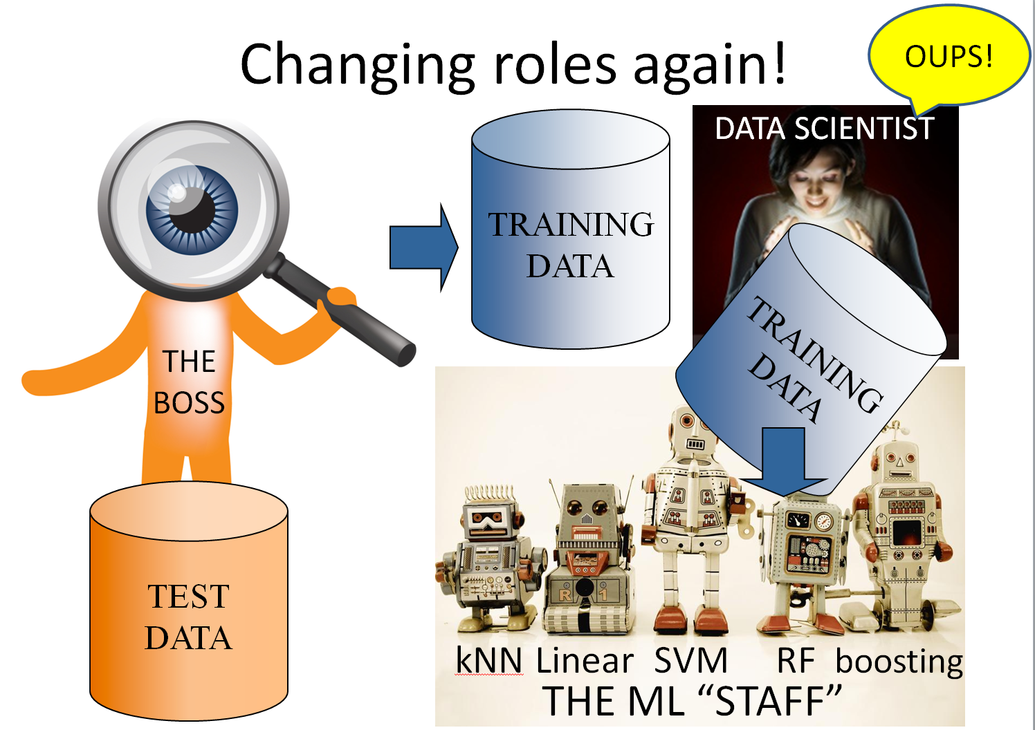
Come to my office hours… Wed 2:30-4:30 Soda 329
Next time

